Slide 1
Observer and Mediator Software Design
Sumner 2015

Slide 2
Another Example

Slide 3
Our job is to create an app that uses the WeatherData object to update three displays for current condition, weather stats, and a forecast.
The system must be expandable – other developer can create new custom display elements and users can add or remove as many display elements as they want.

Slide 4
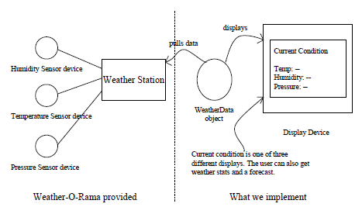
The Weather Monitoring Application

Slide 5
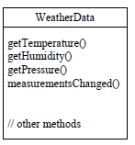
The Weather Data Object
Our job is to implement measurementChanged() so that it updates the three displays for current condition, weather stats, and a forecast.

Slide 6
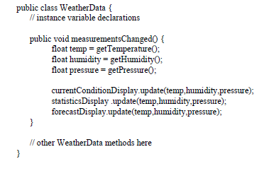
First Implementation

Slide 7
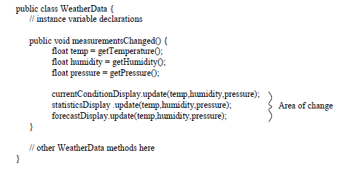
What’s wrong with the first implementation

Slide 8
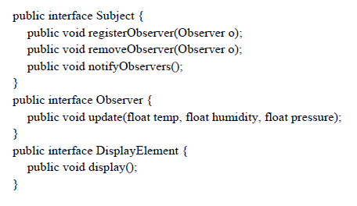
Reimplementing The Weather Station

Slide 9
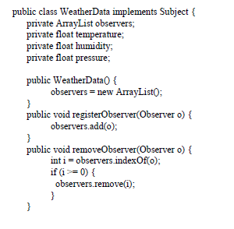
The Weather Data (1)

Slide 10
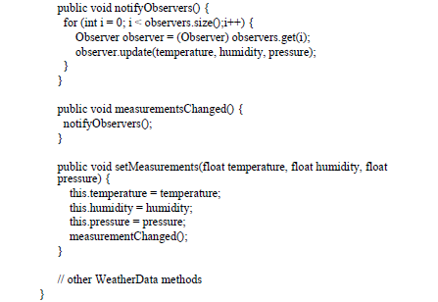
The Weather Data (2)

Slide 11
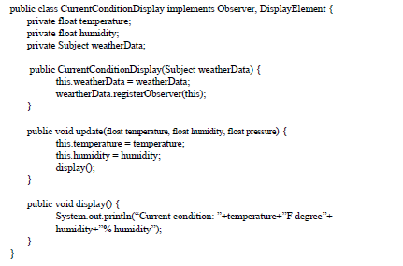
Observer

Slide 12
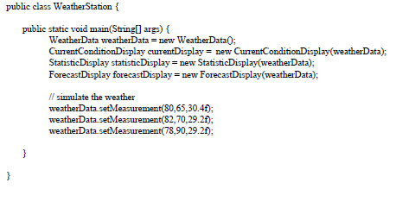
The Weather Station

Slide 13
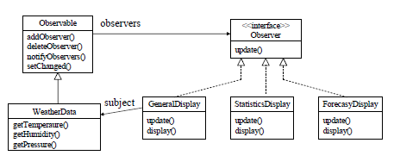
Reworking The Weather Station

Slide 14
Observer Pattern
Defines a “one-to-many” dependency between objects so that when one object changes state, all its dependents are notified and updated automatically
a.k.a Dependence mechanism / publish-subscribe / broadcast / change-update

Slide 15
Subject & Observer
Subject
the object which will frequently change its state and upon which other objects depend
Observer
the object which depends on a subject and updates according to its subject's state.

Slide 16
Observer Pattern: Known Use
Smalltalk Model/View/Controller (MVC). User interface framework while Model is subject and View is observer.
Smalltalk ET++, and the THINK class library provide the general Observer pattern.
Other user interface toolkits such as InterViews, the Andrew Toolkit, and Unidraw.

Slide 17
Observer Pattern Key features
Participants and collaborators
“Subject knows its Observers because the Observers register with it”??
The Subject must notify the Observers when the event in question occurs.
The Observers are responsible both for registering with the Subject and for getting the information from the Subject when notified.

Slide 18
Observer pattern - how it works
Basic Steps:
Step 1: make the observers behave in the same way
Step 2: have the observers register themselves
Step 3: notify the observers when event occurs
Step 4: Update the observers
Basic Responsibilities:
R1: Mapping subjects to their observers
R2: Who trigger the notification
R3: Update the states of observers
R4: Observer Registration

Slide 19
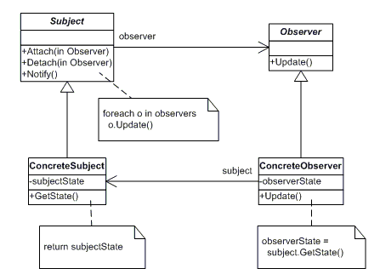
Observer pattern - structure

Slide 20
Observer pattern - participants
Subject: an interface
Provides primitives for managing Observers
Know all of its Observers
Defines notify() to send messages to all Observers
ConcreteSubject:
Stores some state of interest
Getter and setter methods for that state
Observer: an interface
Defines update() to enable messages from Subjects
ConcreteObserver:
Gets pinged via update() and retrieves state changes

Slide 21
Decisions to make
R1: Maintaining the mapping between subjects and observers
A collection in the ConcreteSubjects?

Slide 22
Decisions to make
R2: Who triggers the notification?
R4: Who manage registration?

Slide 23
Decisions to make
R3: When to trigger the update?
Option 1: have all state-setting operations on concreteSubjects call the notify() method after they change the subject’s state.
The client making the state change doesn’t have to remember that.
Automatic, contextual updates
Option 2: make clients call notify() at the right time.
Can wait to trigger the update.
Additional client responsibility.

Slide 24
The Power of Loose Coupling
The Observer Pattern provides an object design where subjects and observers are loosely coupled
We can add new observers at any time
We never need to modify the subject to add new types of observers
We can reuse subject and observers independently of each other
Changes to either the subject or an observers will not affect the other

Slide 25
Java Support for the Observer Pattern
Java.util
Observer interface --Observers
Observable class --Subject

Slide 26
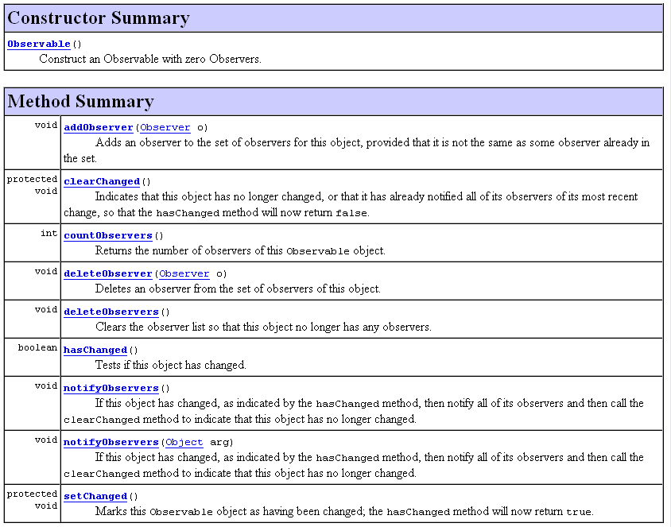

Slide 27

Observe Interface

Slide 28
How Java’s built-in Observer Pattern works
For an object to become an observer…
implement the Observer interface and call addObserver() on any Observable object
For the Observable to send notifications…
call the setChanged() method to signify that the state has changed in your object
call one of two notifyObservers() methods
either notifyObservers() or notifyObservers(Object arg)
For an Observer to receive notifications…
Implement the update(Observable o, Object arg) method

Slide 29
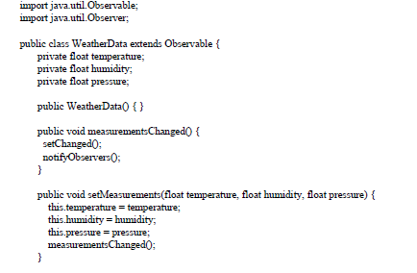
The weather data

Slide 30
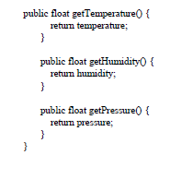
The weather data (2)

Slide 31
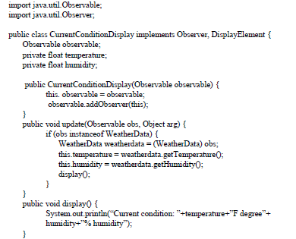
Current Condition Display

Slide 32
The dark side of java.util.Observable
Observable is a class
You have to subclass it. That means you can’t add on the Observable behavior to an existing class that already extends another superclass (limit its reuse potential).
Observable protect crucial method (setChanged())
You can’t call setChanged() unless you’ve subclass Observable. You can’t create an instance of the Observable, you have to subclass.

Slide 33
Additional Decisions to make
Observing more than one subject
update(Subject s)

Slide 34
Additional Decisions to make
State propagation protocols

Slide 35
Addition Decisions to make
Broadcasting State changes
Option 1 - pull model:
The subject sends nothing but the most minimal notification.
The observer ask for details explicitly thereafter.
Emphasizes the subject’s ignorance of its observers
Option 2 - push model:
The subject sends observers the details of the change
The subject knows how the observers expect to receive its state changes

Slide 36
Push vs. Pull
This solution pushes data to the observers
public void Update( float temperature, float humidity, float pressure) {
this.temperature = temperature;
this.humidity = humidity;
Display(); }
The observers may not use all of the data or may need different data?
Observers can pull the specific data they need from the subject
public void Update( IWeatherPublisher weatherData ) {
this.temperature = weatherData.Temperature;
this.humidity = weatherData.Humidity;
Display();
}

Slide 37
Additional Decisions to make
Specifying modifications of interest explicitly

Slide 38
Specifying modifications of interest explicitly:
Subject:
void attach(Observer obs, Aspect interest);
Observer:
void update(Subject subj, Aspect interest);

Slide 39
Additional Decisions to make
How do you encapsulate complex Subject/Observer relationships?
Example: imagine a transactional change
with setState() operations spanning multiple Subjects
Observers to be notified only at the end of transaction
Must capture that specific logic
What would you do?

Slide 40
Decisions Summary
Basic responsibilities:
R1: Manage the mapping between subjects and observers
R2: Trigger the notification
R3: Update the observer
R4: Observer Registration
Additional Responsibilities:
Which class triggers the update
Observing more than one subject
Specifying modifications of interest explicitly
Encapsulating complex update semantics

Slide 41
Observer pattern
Classification:
Behavioral purpose; Object scope
Context: When you need to maintain consistency between states of multiple separate objects without coupling them tightly
Problem: Define one-to-many, loosely coupled dependencies between objects, to automatically notify dependent objects of state changes in object they depend upon
Solution: Publish/subscribe model allows for loose coupling and automatic propagation of state from Subjects to Observers
Consequences:
Support for broadcast mode of communication
Unexpected updates

Slide 42
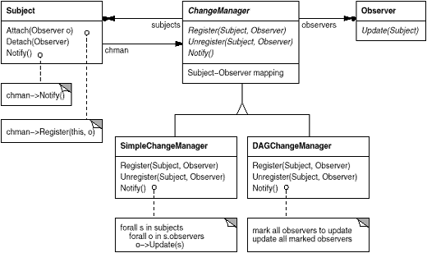
Variant - ChangeManager

Slide 43
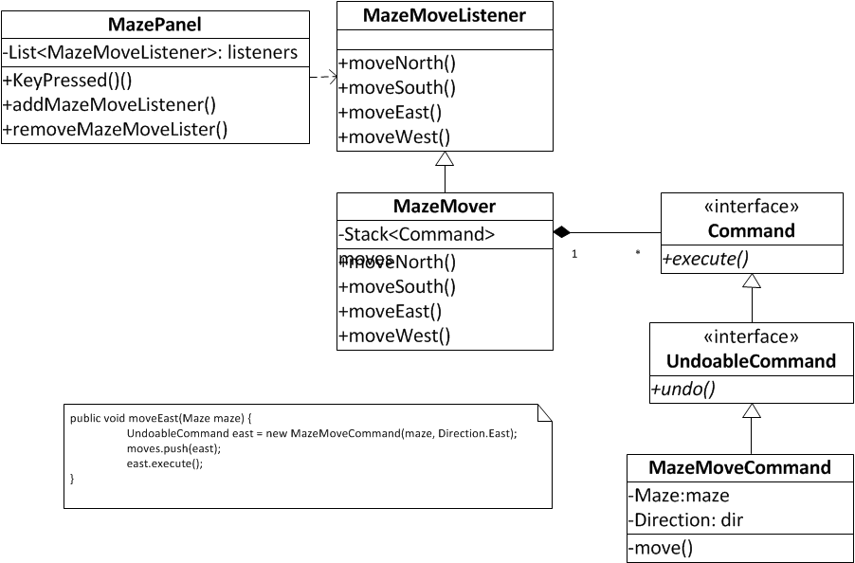
Make Maze Move Undoable

Slide 44
In the MazeGame GUI

Slide 45
Observer pattern - structure

Slide 46
Observer Pattern - Example
a
b
c
b
Observers
x
60
30
10
a
c
y
50
30
20
z
80
10
10
a b c
a = 50%
b = 30%
c = 20%
Subject
requests, modifications
change notification

Slide 47
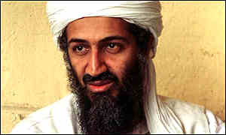






Real World Example
“General Broadcast”
Observers “tuning in” to the notification

Slide 48
Data Example
Interface
Browser
PDA
Cell Phone
Terminal
XML
xyz…
Data is sent to the various observers
Web
Browser
PDA
Cell
Phone
Terminal
Observers

Slide 49
What if the interaction among objects are complex?

Slide 50
Mediator

Slide 51
Mediator Benefits
Increases the reusability of objects supported by the Mediator by decoupling them from the system
Simplifies maintenance of the system by centralizing control logic
Simplifies and reduces the variety of messages sent between objects in the system

Slide 52
Mediator Uses and Drawbacks
The Mediator is commonly used to coordinate related GUI components
A drawback of the Mediator pattern is that without proper design, the Mediator object itself can become overly complex

